Slide 1

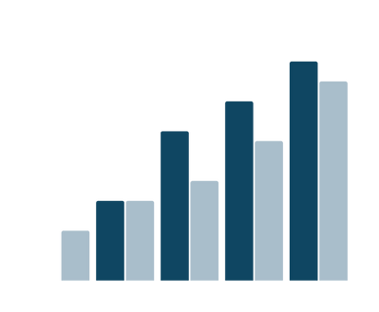
Data Engineering Project
Real-time Data Processing

Slide 2
Project Overview:
This project aims to create a real-time data processing solution for analysing streaming datasets using Azure Data Factory and Azure Databricks.
The solution involves ingesting data to databricks from Azure data lake Gen 2 storage and processing it using Azure Databricks with Spark Streaming along with ETL pipeline execution using ADF. The processed data is then analysed in near-real time to derive actionable insights.
This solution demonstrates the capabilities of Azure services for building scalable and efficient real-time data pipelines.

Slide 3
Tools Used:
Azure Data Lake Gen 2 Storage
Azure Databricks
Azure Data Factory
Project Requirement:
Data Ingestion Requirements
Data cleaning and Transformation Requirements
Data Analysis Requirements
Pipeline Requirements
Scheduling Requirements
Other Non-Functional Requirements

Slide 4
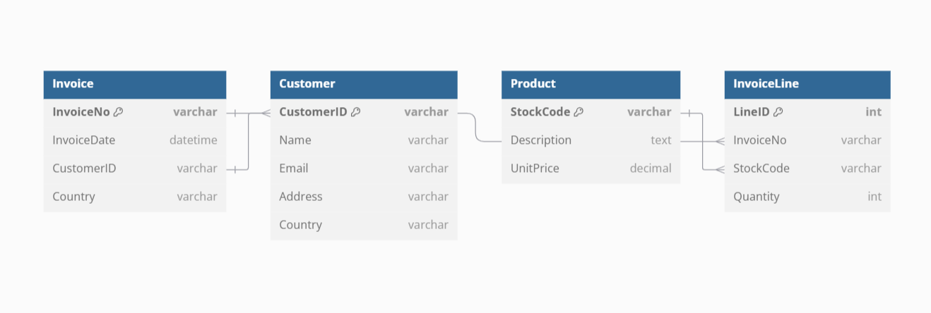
Design (ER Diagram):
Data Overview: The Online Retail dataset contains transactional data from a UK-based e-commerce store spanning the years 2009 to 2011. (From Kaggle)

Slide 5
Overall Workflow:
Azure Data Factory (ADF) orchestrates the execution and monitoring of Azure Databricks notebooks. The data pipeline begins with importing datasets from Kaggle into Azure Data Lake Storage Gen2 (ADLS), where raw data is stored in the Bronze zone (landing zone).
Data from the Bronze zone is processed using Azure Databricks notebooks. In the first notebook, the raw data is cleaned and merged into a unified table, with the output stored in Delta tables within the Silver zone (standardization zone).
The Silver zone data is further transformed using Azure Databricks PySpark and Spark SQL in the second notebook. The cleaned and structured data is joined, aggregated, and prepared for analytical and visualization purposes. Finally, the transformed data is loaded into the Gold zone (analytical zone).

Slide 6
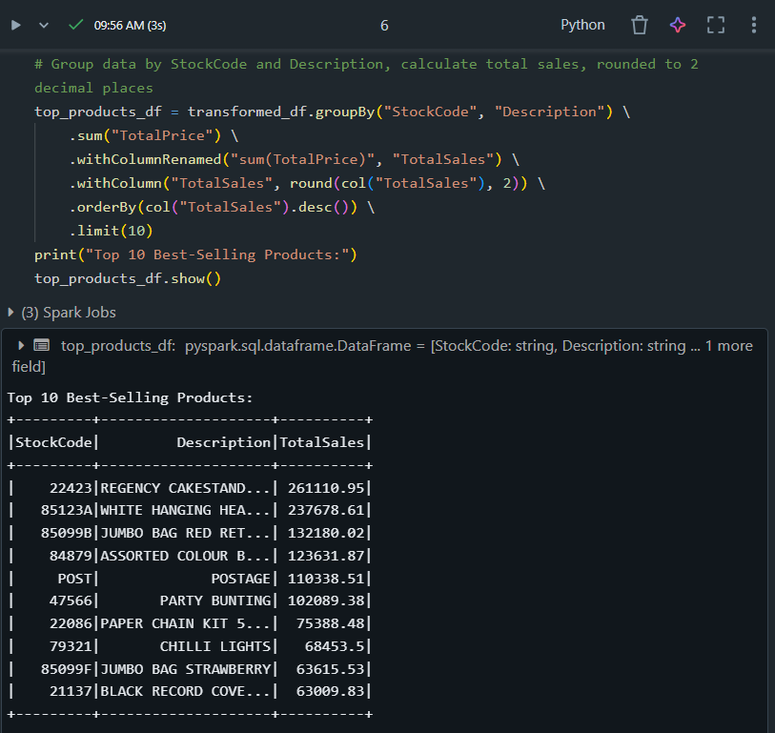
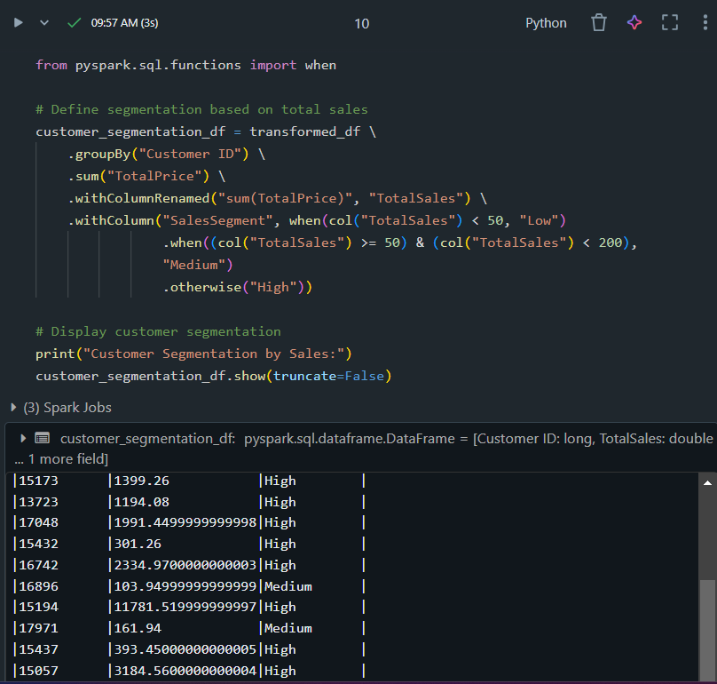
Demo: Sample ETL codes in Databricks

Slide 7
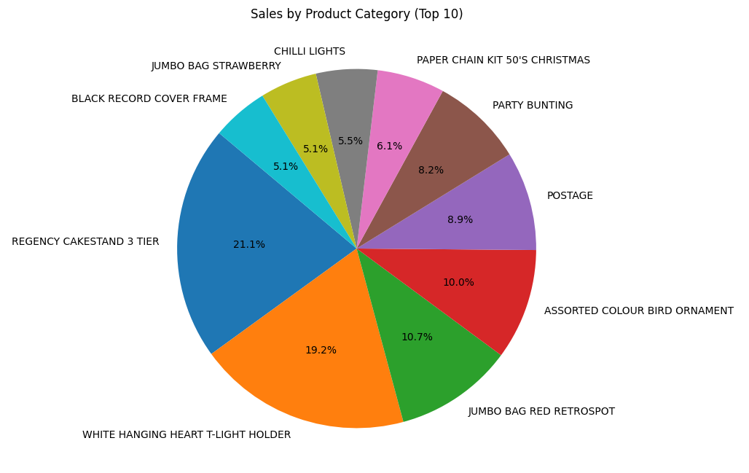
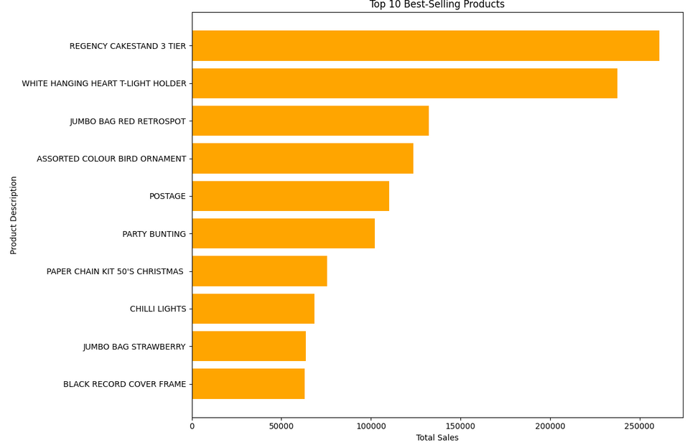
Output:

Slide 8
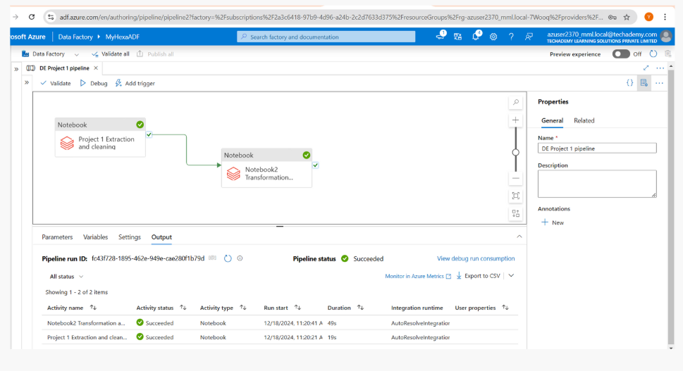

Slide 9
Conclusion:
This project demonstrates a robust data processing pipeline using Azure Data Factory and Databricks, ensuring efficient data ingestion, transformation, and loading into Delta tables for analytical use.

Slide 10
Thank you
S.Yazhini
Akansha Singh
Harshini V

